Slide 1
Week 29
Mamba relative works

Slide 2
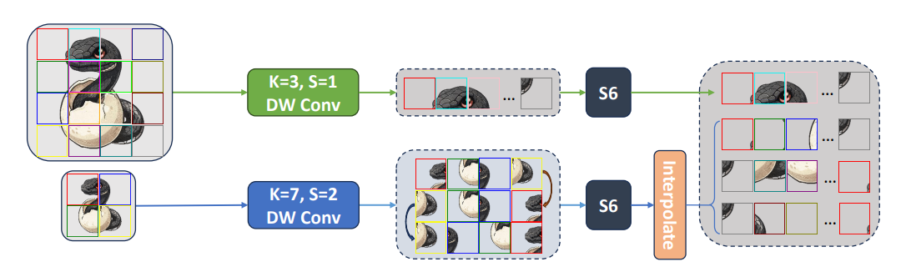
Multi-Scale VMamba: Hierarchy in Hierarchy Visual State Space Model

Slide 3
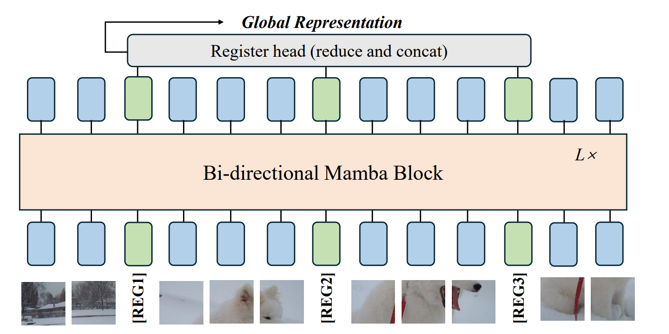
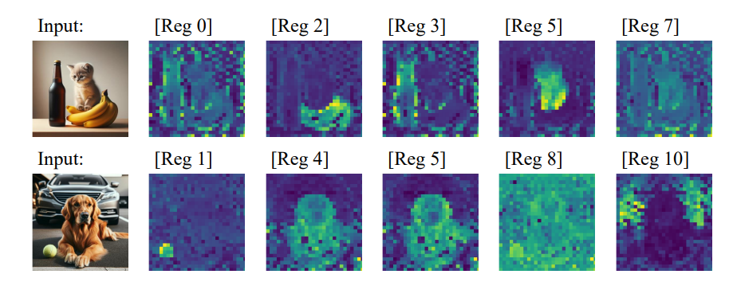
Mamba®: Vision Mamba ALSO Needs Registers

Slide 4
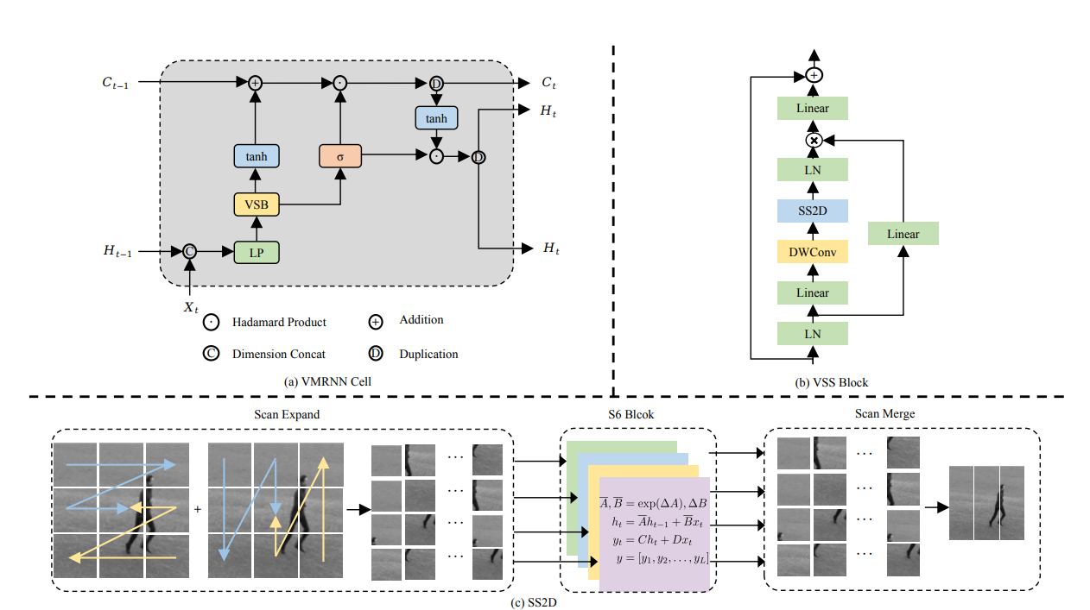
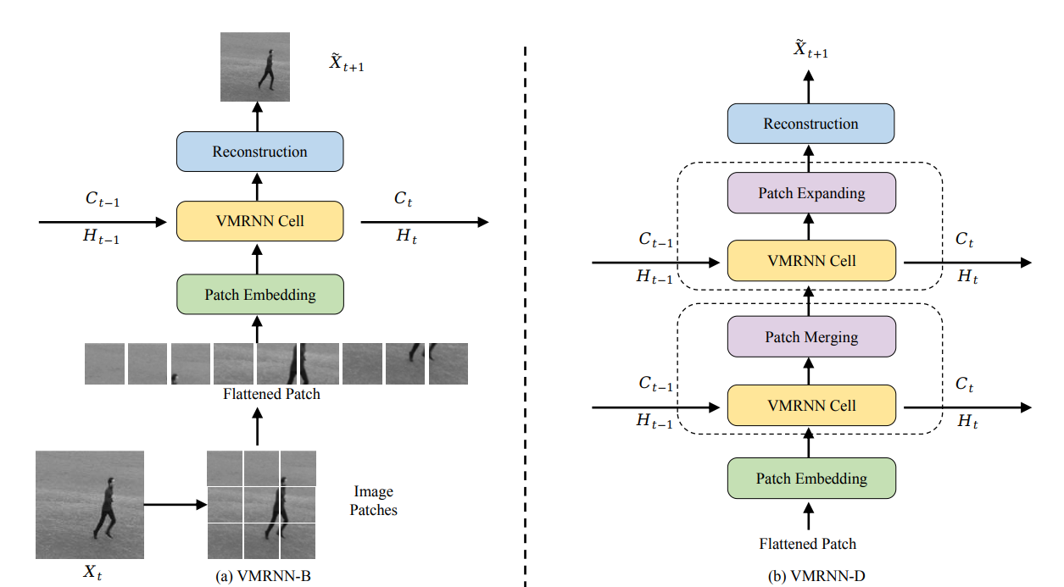
VMRNN: Integrating Vision Mamba and LSTM for Efficient and Accurate Spatiotemporal Forecasting

